Slide 1
Lecture 14 Shortest Path (cont’d) Minimum Spanning Tree

Slide 2
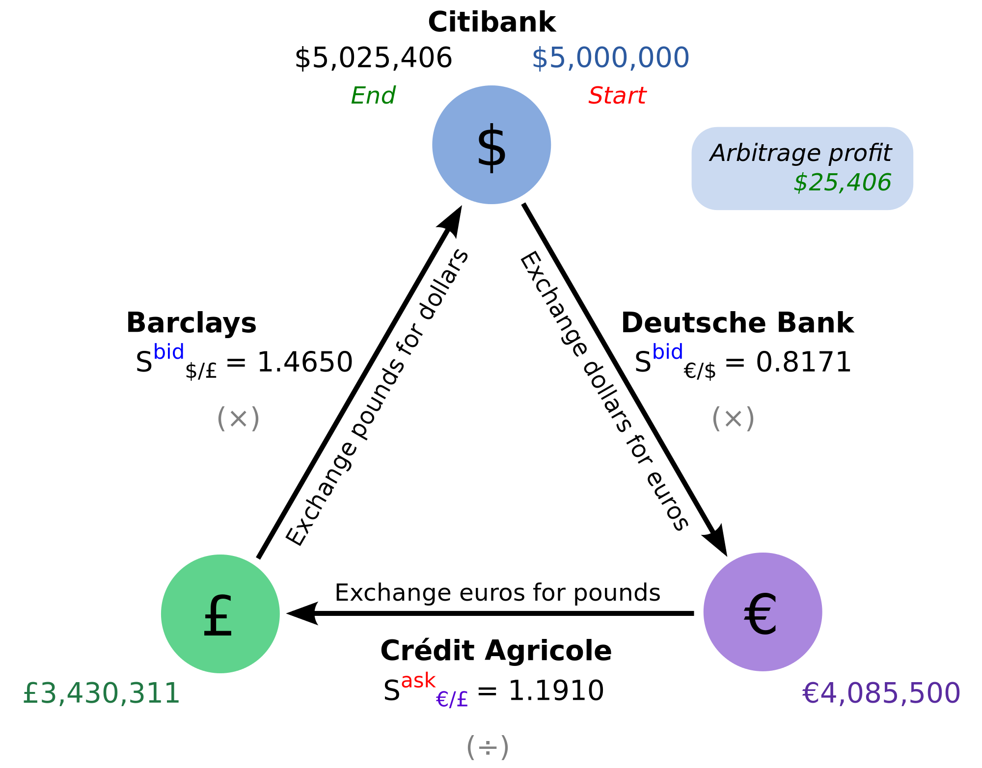
Shortest Path with negative edge length
What is w(u,v) can be negative?
Motivation: Arbitrage
Image from wikipedia

Slide 3
Modeling arbitrage
Suppose u, v are different currency, exchange rate is C(u,v) (1 unit of v is worth C(u,v) units of u)
Let length of edge w(u,v) = log C(u,v)
Length of a path = log of the total exchange rate
Shortest path = best way to exchange money.
Negative cycle = arbitrage.

Slide 4
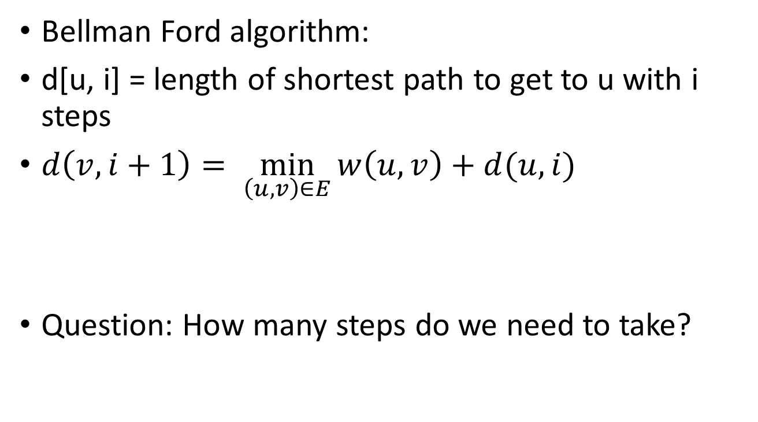
Approach: dynamic programming with steps
Bellman Ford algorithm:
d[u, i] = length of shortest path to get to u with i steps
$d\left(v,i+1\right)= \min_{\left(u,v\right)∈E}{w\left(u,v\right)+d(u,i)}$
Question: How many steps do we need to take?
Length of last step
Shortest Path to a Predecessor

Slide 5

Naïve implementation
Slight modification:
d[u, i] = length of shortest path to get to u with at most i steps
$d\left(v,i+1\right)=\min{\{d(v,i),\min_{\left(u,v\right)∈E}{w\left(u,v\right)+d(u,i)}\}}$
Initialize d[s, 0] = 0, d[u, 0] = infinity for other u
FOR i = 1 to n
Initialize d[u, i] = d[u, i-1] for all i
FOR all edges (u,v)
IF w[u,v]+d[u,i-1] <= d[v,i] THEN
d[v,i] = w[u,v]+d[u,i-1]
IF there is a vertex such that d[u,n] <> d[u,n-1] THEN
There is a negative cycle!

Slide 6
How to detect a negative cycle?
When the graph has no negative cycle, a shortest path can only contain n-1 edges. (why?)
If the graph has a negative cycle, then there is a vertex whose shortest path with n edges is shorter than all paths with at most n-1 edges.

Slide 7
Practical Implementation
Running time:
Each iteration takes O(m) time (O(1) per edge)
There are n iterations.
Total running time O(mn)
In practice can be implemented to run efficiently for many graphs
Only consider outgoing edges from u if d[u,i] < d[u,i-1]
Use a queue to keep track of which vertices are “updated”

Slide 8

Minimum Spanning Tree

Slide 9
Minimum Spanning Tree
Input: Undirected graph with edge weights
Edge Weight: w[u,v] = cost of connecting two vertices u,v
w[u,v] > 0
Goal: Select a subset of edges such that every pair of vertices can be connected by these edges. Minimize the total weight of the edges selected.
Observation: Only need to select n-1 edges and form a tree.

Slide 10
Key Property?
Recall: Any sub-path of a shortest path is still a shortest path.
➔ Dynamic programming based algorithms.
What properties does minimum spanning tree have?

Slide 11
Trees and cycles
Adding any non-tree edge to a tree will introduce a cycle
For a tree with a cycle, removing any edge in the cycle results in a tree.
Basic operation: add an edge and remove another edge in the cycle created (swap).

Slide 12
Why swap?
We will use this to give greedy algorithms for MST.
Recall: Greedy algorithm, general recipe for proof
Assume optimal solution is different from the current solution
Try to find the first place the two solutions differ
Try to modify OPT so that it looks similar to ALG (use swap here!)

Slide 13

Cuts in Graphs
A cut is a subset of edges that separates the vertices into two parts
A cut is usually specified by a subset of vertices $\left(S, \overline{S}\right)$, S is one part of the vertices, $\overline{S}$ is the set of remaining vertices.

Slide 14
Question for the greedy algorithm
Given a cut, which edge should we use?
Idea: Use the shortest one (with minimum cost).
(Note: Eventually we may use multiple edges in the cut, this only decides which is the first edge we use)

Slide 15

Key Property
Key Lemma: Suppose F is a set of edges that is inside some MST T, if $\left(S, \overline{S}\right)$ is a cut that does not contain any edge in F and e is the minimum cost edge in the cut, then it is safe to add e to F.
$F∪\left\{e\right\}⊂T′$ for some MST T’

Slide 16
General Algorithm for MST
Initialize the tree to be empty. (initially a subset of some MST)
Repeat
Find a cut that does not have any edge in the current tree
Add the min cost edge of the cut to the tree (by Key Lemma: still a subset of some MST)
Until the tree has n-1 edges (Now we already have a tree, so it must be a MST)

